Slide 1
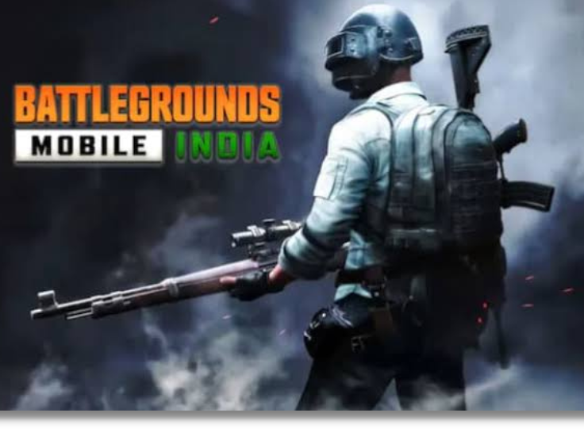
Shri ShankaraCharya Technical Campus
BGIS
eSport
Presented By
Harshit Kumar Sinha
Sec. B, 28
Computer Science And Engineering

Slide 2
Acknowledgement
I would like to express my special thanks of gratitude to my teacher Mrs. Snehlata Mandal
who gave me the golden opportunity to do this wonderful project on the Mini Project,
which also helped me in doing a lot of Research and i came to know
about so many new things I am really thankful to them.
While I was making this project , a lot of information that I found helped me in programming
and I am glad that I was able to complete this project and was able to understand many things.
I am making this project not only for marks but to also increase my knowledge.
(Signature of student)

Slide 3



Tools & Technology Used
HTML
Bootstrap
CSS
JavaScript

Slide 4
HTML Code
<!doctype html>
<html lang="en">
<head>
<meta charset="utf-8">
<meta name="viewport" content="width=device-width, initial-scale=1">
<!-- Bootstrap CSS -->
<link href="https://cdn.jsdelivr.net/npm/bootstrap@5.1.3/dist/css/bootstrap.min.css" rel="stylesheet"
integrity="sha384-1BmE4kWBq78iYhFldvKuhfTAU6auU8tT94WrHftjDbrCEXSU1oBoqyl2QvZ6jIW3" crossorigin="anonymous">
<link rel="stylesheet" href="CSS/a.css">
<title>Mini-Project</title>
</head>

Slide 5
<body>
<nav class="navbar navbar-expand-lg navbar-dark bg-dark">
<div class="container-fluid">
<a class="navbar-brand text-warning" href="#">BGIS</a>
<button class="navbar-toggler" type="button" data-bs-toggle="collapse" data-bs-target="#navbarSupportedContent"
aria-controls="navbarSupportedContent" aria-expanded="false" aria-label="Toggle navigation">
<span class="navbar-toggler-icon"></span>
</button>
<div class="collapse navbar-collapse" id="navbarSupportedContent">
<ul class="navbar-nav me-auto mb-2 mb-lg-0">
<li class="nav-item">
<a class="nav-link active text-warning" aria-current="page" href="#about">About</a>
</li>
<li class="nav-item">
<a class="nav-link active text-warning" aria-current="page" href="#prize">PrizePool</a>
</li>
<li class="nav-item">
<a class="nav-link active text-warning" aria-current="page" href="#alumnis">Alumnis</a>
</li>
</ul>
</div>
</div>
</nav>

Slide 6
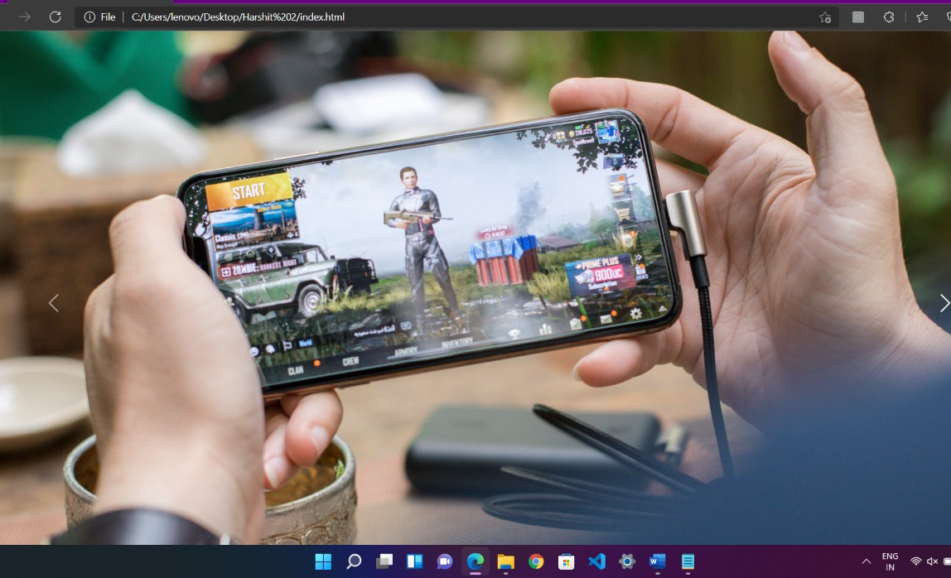

Slide 7
<section class="home" id="home">
<div id="carouselExampleCaptions" class="carousel slide" data-bs-ride="carousel">
<div class="carousel-indicators">
<button type="button" data-bs-target="#carouselExampleCaptions" data-bs-slide-to="0" class="active"
aria-current="true" aria-label="Slide 1"></button>
<button type="button" data-bs-target="#carouselExampleCaptions" data-bs-slide-to="1"
aria-label="Slide 2"></button>
<button type="button" data-bs-target="#carouselExampleCaptions" data-bs-slide-to="2"
aria-label="Slide 0"></button>
</div>
<div class="carousel-inner">
<div class="carousel-item active">
<img src="Image/carousal3.jpg" class="d-block w-100" alt="...">
<div class="carousel-caption d-none d-md-block">
</div>
</div>
<div class="carousel-item">
<img src="Image/carousal2.jpg" class="d-block w-100" alt="...">
<div class="carousel-caption d-none d-md-block">
</div>
</div>
<div class="carousel-item">
<img src="Image/carousal1.jpg" class="d-block w-100" alt="...">
<div class="carousel-caption d-none d-md-block">
</div>
</div>
</div>
<button class="carousel-control-prev" type="button" data-bs-target="#carouselExampleCaptions" data-bs-slide="prev">
<span class="carousel-control-prev-icon" aria-hidden="true"></span>
<span class="visually-hidden">Previous</span>
</button>
<button class="carousel-control-next" type="button" data-bs-target="#carouselExampleCaptions" data-bs-slide="next">
<span class="carousel-control-next-icon" aria-hidden="true"></span>
<span class="visually-hidden">Next</span>
</button>
</div>
</section>

Slide 8
<section class="about " id="about">
<div class="contentBx">
<h3 class="titleText"><span>A</span>bout</h3>
<p class="text text-white my-4">BGIS is a global leader in the provision of Facility Management, Project Delivery, Energy & Sustainability, Asset
Management, Workplace Advisory, and Real Estate Services. With a combined team of over 8,000 globally, BGIS relentlessly
focuses on delivering innovative service solutions that create value for its clients.<br><br> <br> The biggest Battlegrounds Mobile India (BGMI) tournament of the year Battlegrounds Mobile India Series 2021 (BGIS) is
about to enter its Round-3 qualifiers from 27th December 2021. For this stage of the tournament, 32 directly invited
teams will be joining the 224 teams that have made its way through the two previous online qualification rounds.
BGIS is generally known as Battleground India Mobile League it is Indian tournament.
<br><br><br>Krafton, a day before the third stage of BGIS 2021, has revealed the names of all the 32 directly invited teams along
with information about their rosters. These invited teams will be mixed with the other 224 teams and divided into 16
groups with 16 teams each. Here is the complete information regarding the invites and details for the remainder of the
tournament.
</p>
</div>
<div class="imgBx">
<img src="Image/about.jpg" alt="">
</div>
</section>

Slide 9
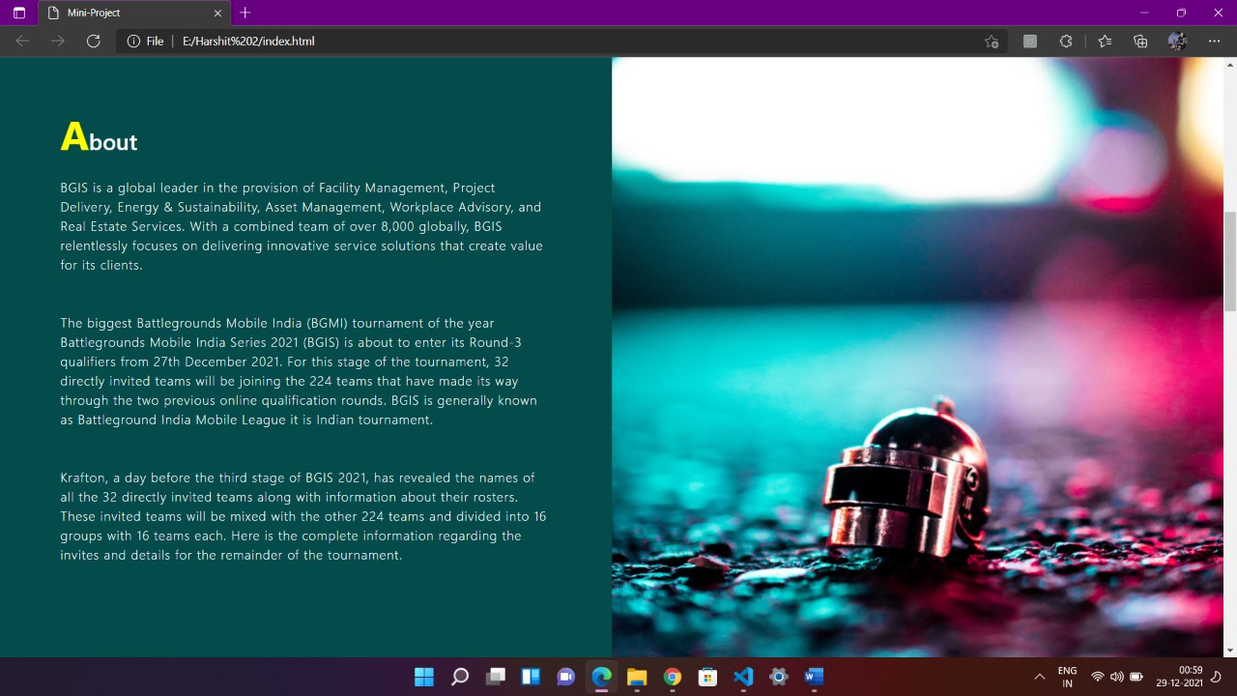

Slide 10
<section id="alumnis" class="alumnis">
<h2 class="text-center text-white spacing fw-bolder titleText"> <span>A</span>lumnis</h2>
<p class="text text-white text-center mx-5 my-3">Below are the some great bgmi players of this era who have achieved too much in a just teenager age which is difficult for others who are of adult ages.</p>
<div class="row mb-2 mx-4 players">
<h3 class="text-center text-warning my-3 ">Famous Gamers</h3>
<div class="col-md-6">
<div class="row g-0 border rounded overflow-hidden flex-md-row mb-4 shadow-sm h-md-250 position-relative">
<div class="col p-4 d-flex flex-column position-static">
<h3 class="mb-0 acolor">Jonathan</h3>
<p class="card-text mb-auto text-white my-4">Jonathan Amaral famously known as Jonathan Pubg and Jonathan's net worth is estimated to be around $150K i.e
approximately 1 Crore in Indian Rupees. Jonathan is a Pubg player who streams his videos on youtube.</p>
</div>
<div class="col-auto d-none d-lg-block ">
<img class="photo mx-2 my-2" src="Image/Player 1).jpeg" alt="">
</div>
</div>
</div>

Slide 11
<section id="alumnis" class="alumnis">
<h2 class="text-center text-white spacing fw-bolder titleText"> <span>A</span>lumnis</h2>
<p class="text text-white text-center mx-5 my-3">Below are the some great bgmi players of this era who have achieved too much in a just teenager age which is difficult for others who are of adult ages.</p>
<div class="row mb-2 mx-4 players">
<h3 class="text-center text-warning my-3 ">Famous Gamers</h3>
<div class="col-md-6">
<div class="row g-0 border rounded overflow-hidden flex-md-row mb-4 shadow-sm h-md-250 position-relative">
<div class="col p-4 d-flex flex-column position-static">
<h3 class="mb-0 acolor">Jonathan</h3>
<p class="card-text mb-auto text-white my-4">Jonathan Amaral famously known as Jonathan Pubg and Jonathan's net worth is estimated to be around $150K i.e
approximately 1 Crore in Indian Rupees. Jonathan is a Pubg player who streams his videos on youtube.</p>
</div>
<div class="col-auto d-none d-lg-block ">
<img class="photo mx-2 my-2" src="Image/Player 1).jpeg" alt="">
</div>
</div>
</div>

Slide 12
<div class="col-md-6">
<div class="row g-0 border rounded overflow-hidden flex-md-row mb-4 shadow-sm h-md-250 position-relative">
<div class="col p-4 d-flex flex-column position-static">
<h3 class="mb-0 acolor">Rex</h3>
<p class="card-text mb-auto text-white my-4">Rishi "Rex" Thakur (born November 29, 2000) is an Indian PUBG Mobile player who currently plays for TeamXSpark. He
is currently a part of 8Bit Creatives as a content creator.</p>
</div>
<div class="col-auto d-none d-lg-block ">
<img class="photo mx-2 my-2" src="Image/Screenshot_20211228-214500__01.jpg" alt="">
</div>
</div>
</div>
<div class="col-md-6">
<div class="row g-0 border rounded overflow-hidden flex-md-row mb-4 shadow-sm h-md-250 position-relative">
<div class="col p-4 d-flex flex-column position-static">
<h3 class="mb-0 acolor">Saimon</h3>
<p class="card-text mb-auto text-white my-4">Mayank Wadhwani "Saimon" is an Indian player and coach who currently is a part of GodLike Esports. He is
also the founder of Team ORB.</p>
</div>
<div class="col-auto d-none d-lg-block ">
<img class="photo mx-2 my-2" src="Image/Screenshot_20211228-214728__01.jpg" alt="">
</div>
</div>
</div>

Slide 13
<div class="col-md-6">
<div class="row g-0 border rounded overflow-hidden flex-md-row mb-4 shadow-sm h-md-250 position-relative">
<div class="col p-4 d-flex flex-column position-static">
<h3 class="mb-0 acolor">Rex</h3>
<p class="card-text mb-auto text-white my-4">Rishi "Rex" Thakur (born November 29, 2000) is an Indian PUBG Mobile player who currently plays for TeamXSpark. He
is currently a part of 8Bit Creatives as a content creator.</p>
</div>
<div class="col-auto d-none d-lg-block ">
<img class="photo mx-2 my-2" src="Image/Screenshot_20211228-214500__01.jpg" alt="">
</div>
</div>
</div>
<div class="col-md-6">
<div class="row g-0 border rounded overflow-hidden flex-md-row mb-4 shadow-sm h-md-250 position-relative">
<div class="col p-4 d-flex flex-column position-static">
<h3 class="mb-0 acolor">Saimon</h3>
<p class="card-text mb-auto text-white my-4">Mayank Wadhwani "Saimon" is an Indian player and coach who currently is a part of GodLike Esports. He is
also the founder of Team ORB.</p>
</div>
<div class="col-auto d-none d-lg-block ">
<img class="photo mx-2 my-2" src="Image/Screenshot_20211228-214728__01.jpg" alt="">
</div>
</div>
</div>

Slide 14
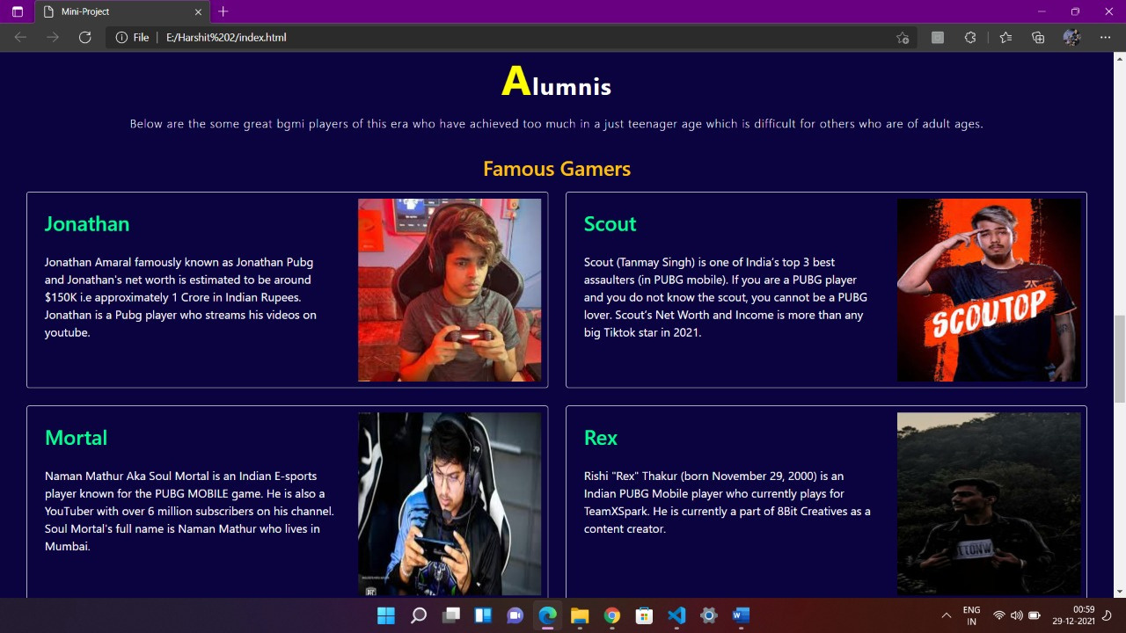

Slide 15
<section class="prize" id="prize">
<div class="contentBx">
<h4 class="titleText"><span>P</span>rize Pool</h4>
<h4 class="mvp my-4"><span>MVP</span>- Awarded to the tournament MVP</h4>
<h4 class="mvp my-4"><span>The Lone Ranger</span>- Awarded to the player with the longest survival time.</h4>
<div class="lists">
<ol class="list-group list-group-numbered">
<li class="list-group-item d-flex justify-content-between align-items-start my-4">
<div class="ms-2 me-auto">
<div class="fw-bold">1st Prize</div>
<p class="my-2">Rs.20,00,000</p>
</div>
</li>
<li class="list-group-item d-flex justify-content-between align-items-start my-4">
<div class="ms-2 me-auto">
<div class="fw-bold">2nd Prize</div>
<p class="my-2">Rs.10,00,000</p>
</div>
</li>
<li class="list-group-item d-flex justify-content-between align-items-start my-4">
<div class="ms-2 me-auto">
<div class="fw-bold">3rd Prize</div>
<p class="my-2">Rs.50,000</p>
</div>
</li>
<li class="list-group-item d-flex justify-content-between align-items-start my-4">
<div class="ms-2 me-auto">
<div class="fw-bold">MVP</div>
<p class="my-2">Rs.1,00,000</p>
</div>
</li>
<li class="list-group-item d-flex justify-content-between align-items-start my-4">
<div class="ms-2 me-auto">
<div class="fw-bold">The Lone Ranger</div>
<p class="my-2">Rs.30,000</p>
</div>
</li>
</ol>
</div>
</div>
<div class="imgBx">
<img src="Image/prizepool.jpg" alt="">
</div>
</section>

Slide 16


Thank you!
Do you have any questions for me?

